Slide 1


Facial Emotion Detection
Jeff Stearns
Notes:
Hear me, see screen okay?
Work at Draper Cambridge

Slide 2
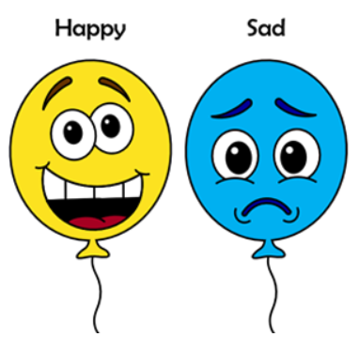
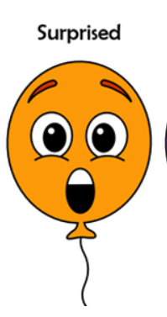


PROBLEM DEFINITION
Can emotion be accurately detected by Convolutional Neural Networks (CNN)?
Average natural human ability to detect emotions is around 90%, can we approach this level?
Notes:
Dataset : Suspect most people < 90%

Slide 3
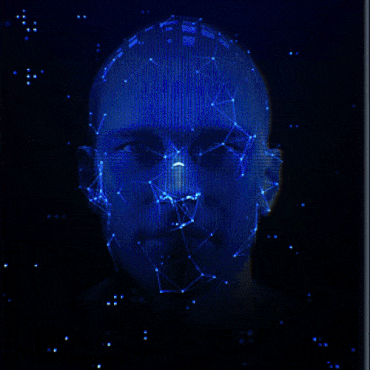
EMOTION DETECTION USE CASES
Self driving car, detect drowsy or distracted.
Potentially assist with security: Predict dangerous behaviors by reading emotions.
Detect emotional response of customers to advertisement.
Notes:
-Self driving : Major potential, serious challenges
-Security : World events increase focus on this AI issue daily
-Marketing : Interactive feedback from customers/potential customers

Slide 4
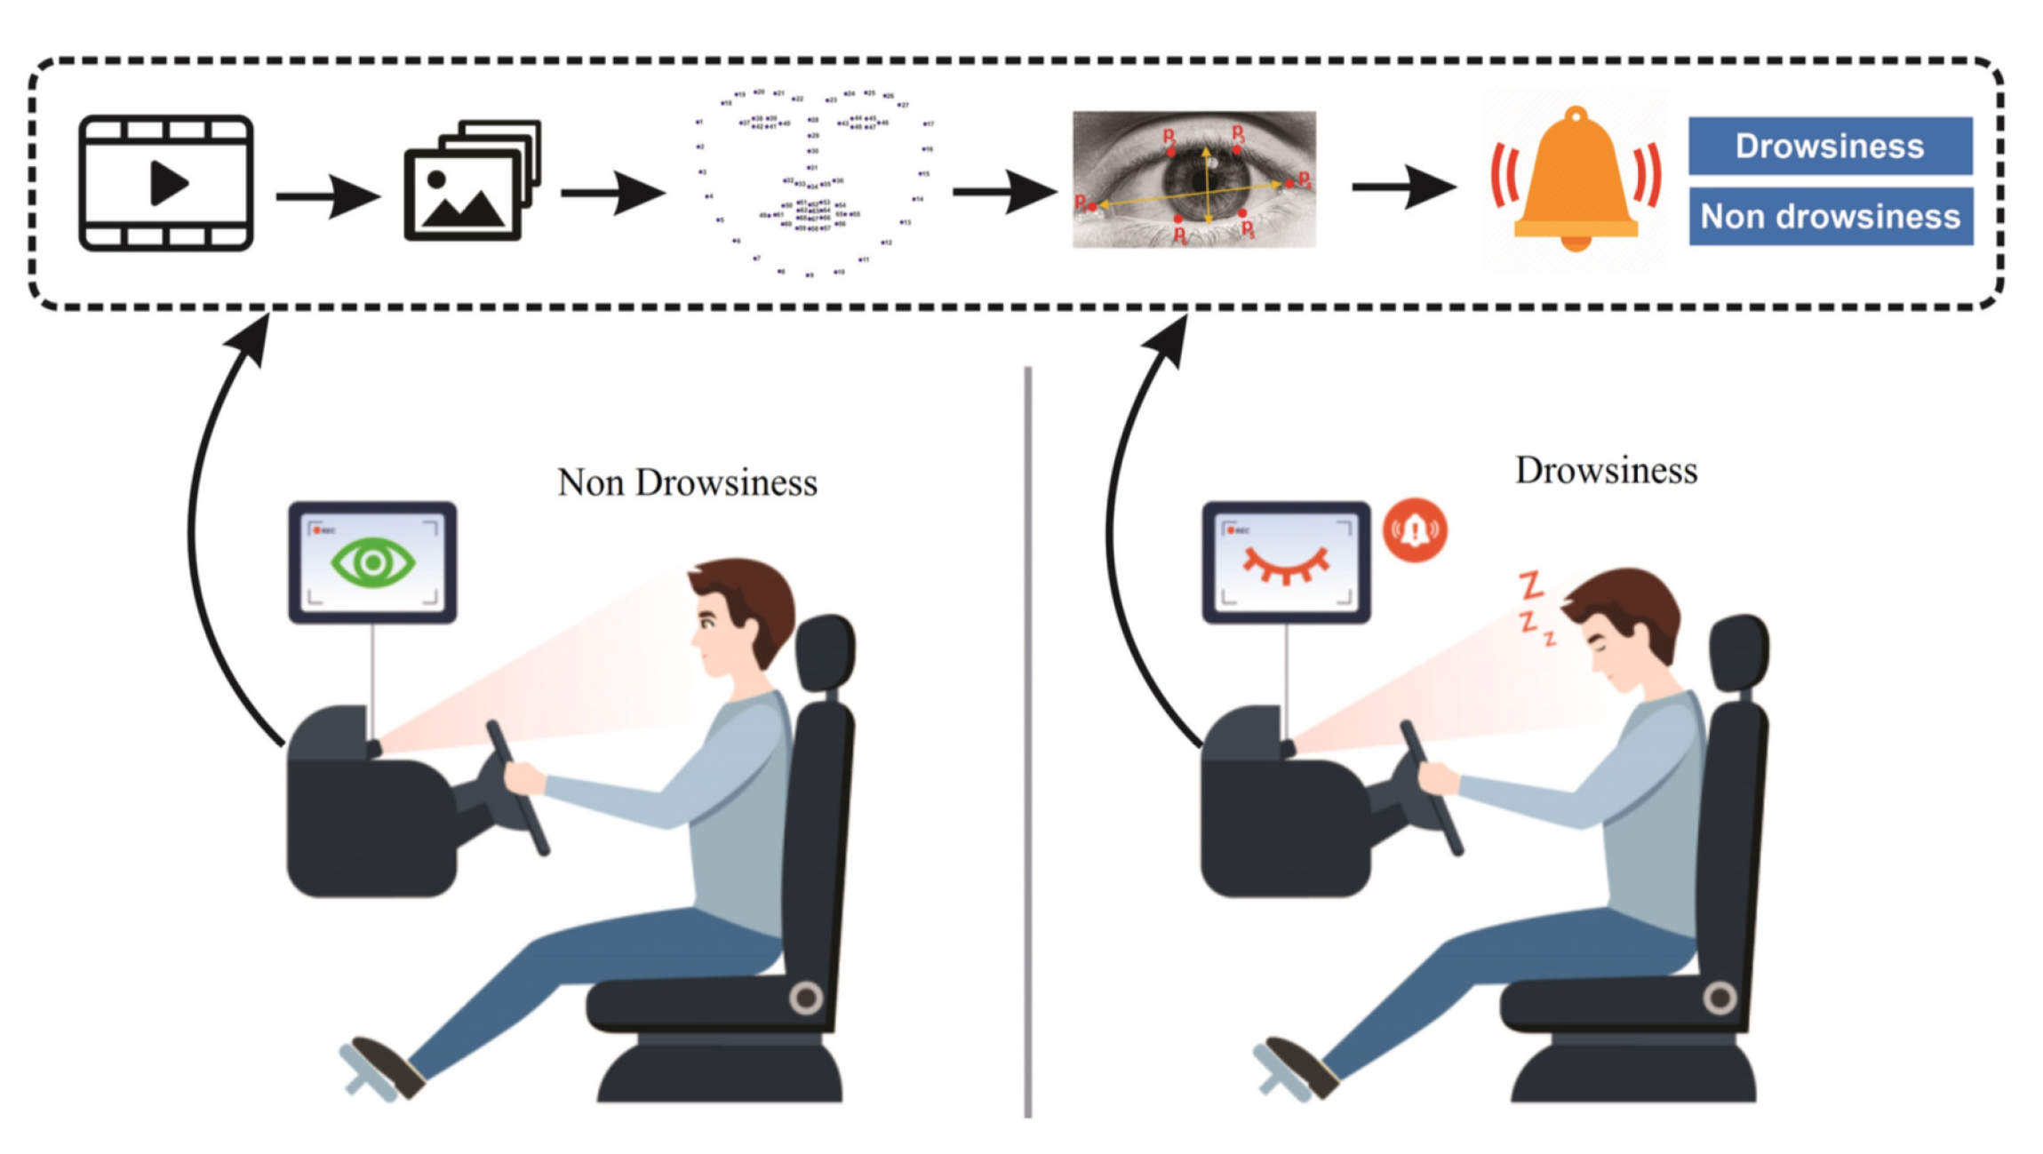
FACIAL EMOTION DETECTION USE CASE 1
Autopilot Automobiles : Driver alertness still required, sensors and software are not perfect.
Notes:
-Active Driving Assistance (ADA) : Available 50 percent of 23 vehicles
-Tesla Autopilot vs Ford BlueCruise vs Mercedes Driver Assist etc
-Simple : Automatic Braking, Cruise Control to Complex : LIDAR
-Direct Driver Monitoring Systems (DDMS) : Keep eyes on the road

Slide 5
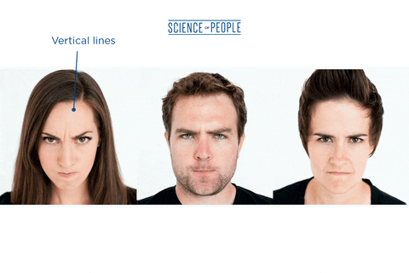
FACIAL EMOTION DETECTION USE CASE 2
Security alert, detect potentially dangerous individual through emotion recognition.
Notes:
-Beyond world hotspots : Airports, Stadiums, Schools

Slide 6
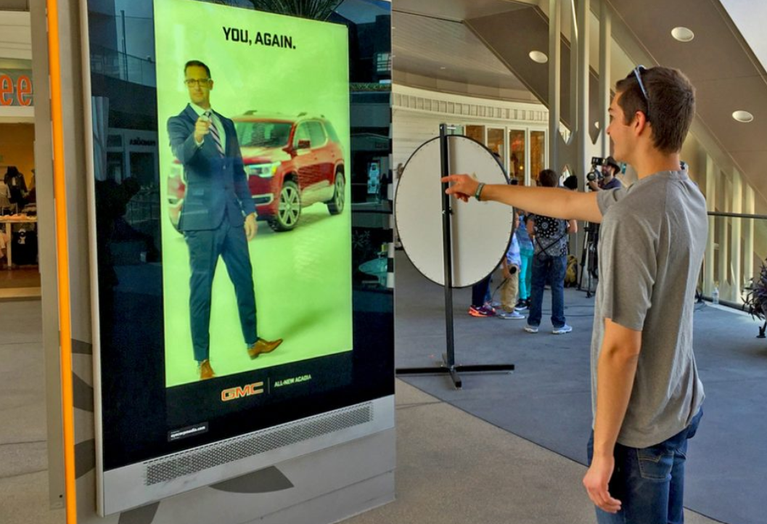
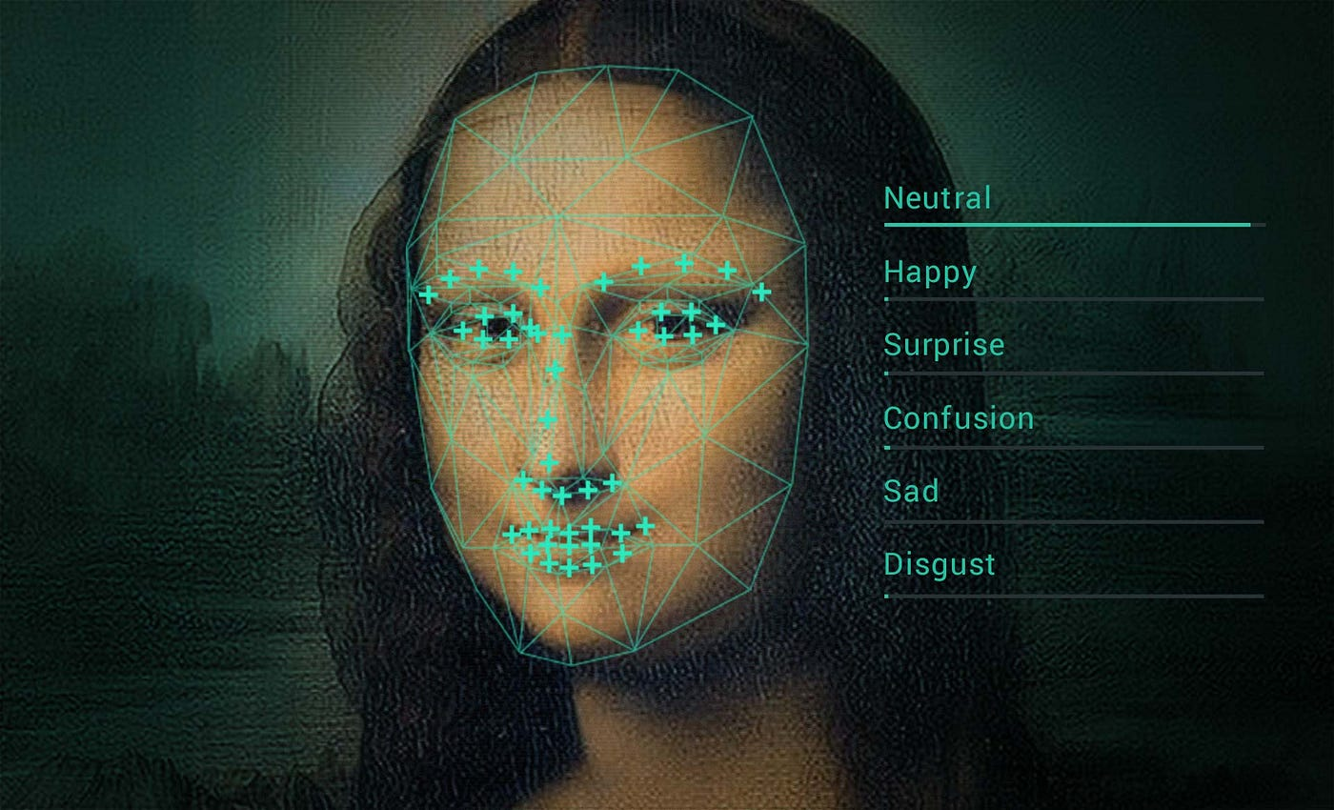
FACIAL EMOTION DETECTION USE CASE 3
Detect emotional response of customers to advertisement.
Notes:
-Killer App : Spreadsheet, VisiCalc 79 Apple II then IBM 83 Lotus 123

Slide 7




DATA SET ANALYSIS
Facial_emotion_images.zip
Black and White Images : 48 Pixel Squares
Example Images
Happy
Neutral
Sad
Surprise

Slide 8
DATA SET ANALYSIS
20,214 Grayscale Images, 48 Pixel Square
Very small TEST set : 60-80 / 10-20 / 10-20 standard ratios
TRAINING | VALIDATION | TEST
Happy 3976 26.3% Sad 3982 26.4% Neutral 3978 26.3% Surprise 3173 21.0% | Happy 3976 36.7% Sad 3982 22.9% Neutral 3978 24.4% Surprise 3173 16.0% | Happy 32 25.0% Sad 32 25.0% Neutral 32 25.0% Surprise 32 25.0%
15109 74.7% | 4977 24.6% | 128 0.6%

Slide 9







DATA SET ISSUES
No face, watermark, multiple face, cartoon, etc…
train\happy
train\sad
test\happy

Slide 10
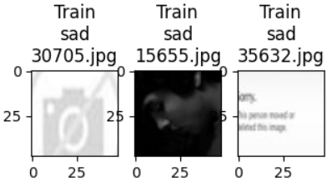
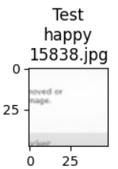
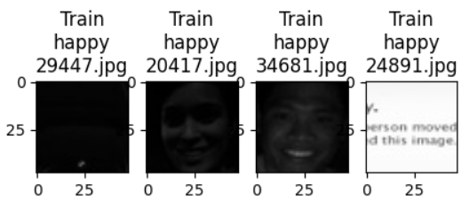
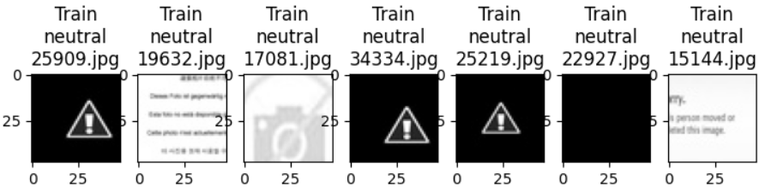
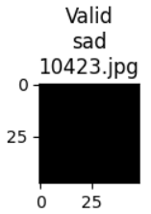
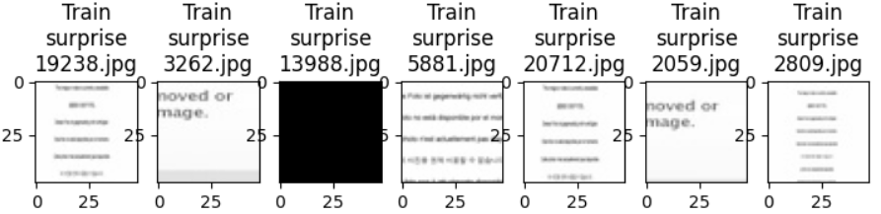
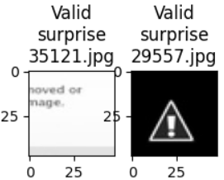
DATA SET IMAGES, NO FACE or TOO DARK
Filter Tool : Reject Images Numpy.Average<20 or >235
25 Images : 21 Train, 3 Validation, 1 Test
Notes:
-Particular images are distracting, especially test/happy
-Statistically inconsequential, 0.1%
-Cleaned Zip

Slide 11
CONVOLUTIONAL NEURAL NETWORK (CNN) MODELS
MODEL | LAYERS | PARAMETERS | COMMENT
Grayscale 1 | 5 : 3 Conv2d | 605,060 | Lowcode Model
Grayscale 2 | 6 : 3 Conv2d | 389,604 | BatchNormalization, Dense
VGG16 | 16 : 13 Conv2d | 14,714,688 | Transfer Model 1, RGB Images
ResNetV2 | 164 : 1000 Categories | 42,658,176 | Transfer Model 2, RGB Images
EfficientNet | B7 : 813 | 8,769,374 | Transfer Model 3, RGB Images
Milestone 1 | 7 : 4 Conv2d | 1,592,324 | Kernel Size 3 & 2, Conv2D added
CapStone | 8 : 5 Conv2d | 2,973,700 | Conv2D Layer Added
Notes:
VGG16, straightforward
EfficientNet : 5 modules

Slide 12
DATASET LOADERS
TENSORFLOW TOOLS
ImageDataGenerator : Image Augmentations Applied
flow_from_directory method
rescale : Normalize pixel values 0-1
horizontal_flip : Teach model differing orientations
rotation_range : Handle random rotation of images
Read data, labels from directory structure
Easier to load and process data in batches
Notes:
Best part of LowCode example reference

Slide 13
CNN MODEL 1
Low Code Notebook Model
We want our Base Neural Network architecture to have 3 convolutional blocks.
Each block contains one Conv2D layer, maxpooling layer and Dropout layers.
Add first Conv2D layer with 64 filters and a kernel size of 2, 'same' padding input shape = (48, 48, 1) if you're using 'grayscale' colormode. Use 'relu' activation.
Add a second Conv2D layer with 32 filters and a kernel size of 2, 'same' padding and 'relu' activation.
Add a third Conv2D layer with 32 filters and a kernel size of 2, 'same' padding and 'relu' activation.
After adding your convolutional blocks, add your Flatten layer.
Add your first Dense layer with 512 neurons. Use 'relu' activation function.
Add a Dropout layer with dropout ratio of 0.4.
Add your final Dense Layer with 4 neurons and 'softmax' activation function
Print your model summary
Notes:
Foundational element for CapStone notebook

Slide 14
CNN MODEL 2
Enhanced Low Code Notebook Model
Conv2D Layer Added
Dense Layer Added
More Neurons per Conv2D Layer
BatchNormalization Added
Notes:
Helpful tips in LowCode for improving upon baseline

Slide 15
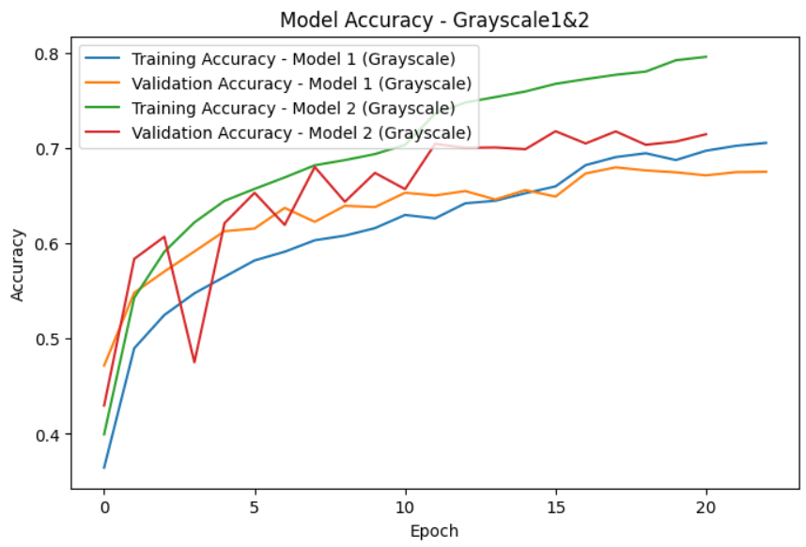
CNN MODELS 1 & 2 GRAPH
Notes:
Bigger gap in Model 2 between Training and Validation
Room for improvement

Slide 16
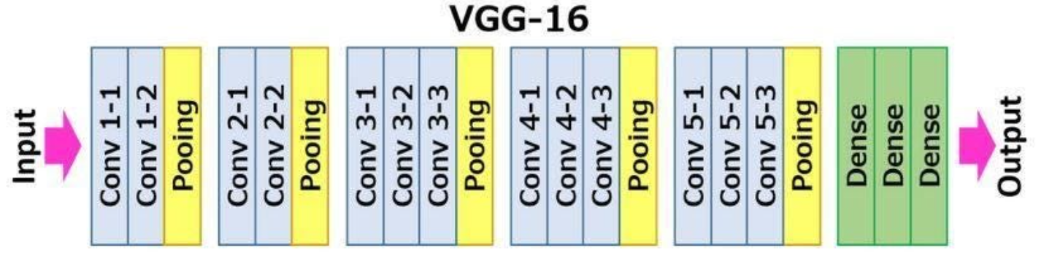
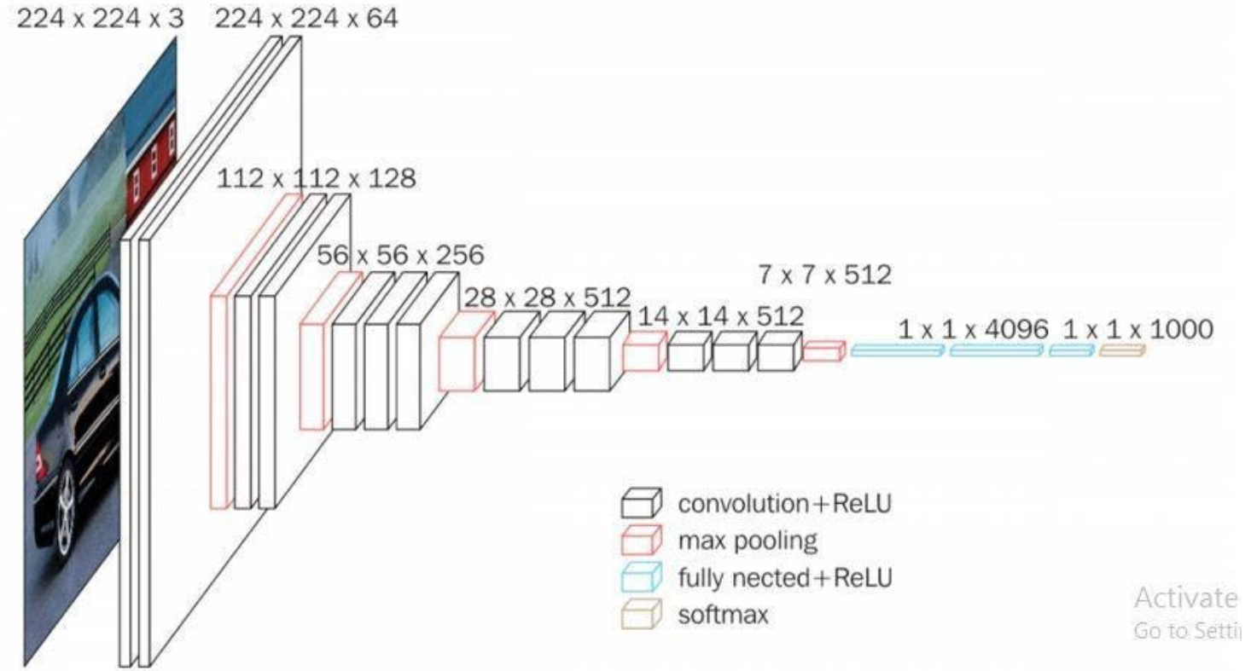
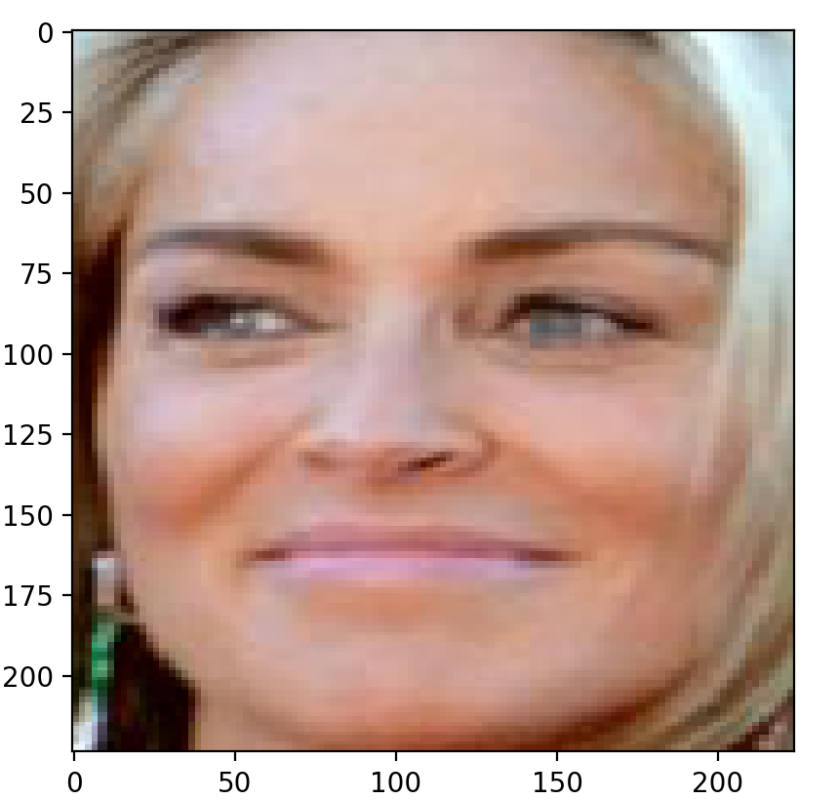
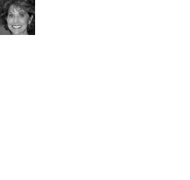
VGG-16 ARCHITECTURE
VGG16 Image vs Facial_emotion_images
65 to 1 Image Data
Similar Grayscale 1 : ~70
Notes:
First glance, 224 x 224 x 3, not that big
Math shows otherwise : 4.67 x 4.67 x 3
Visually can see dramatic difference

Slide 17
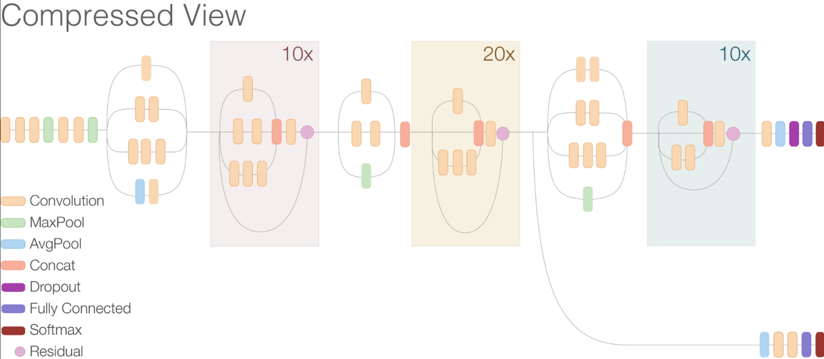
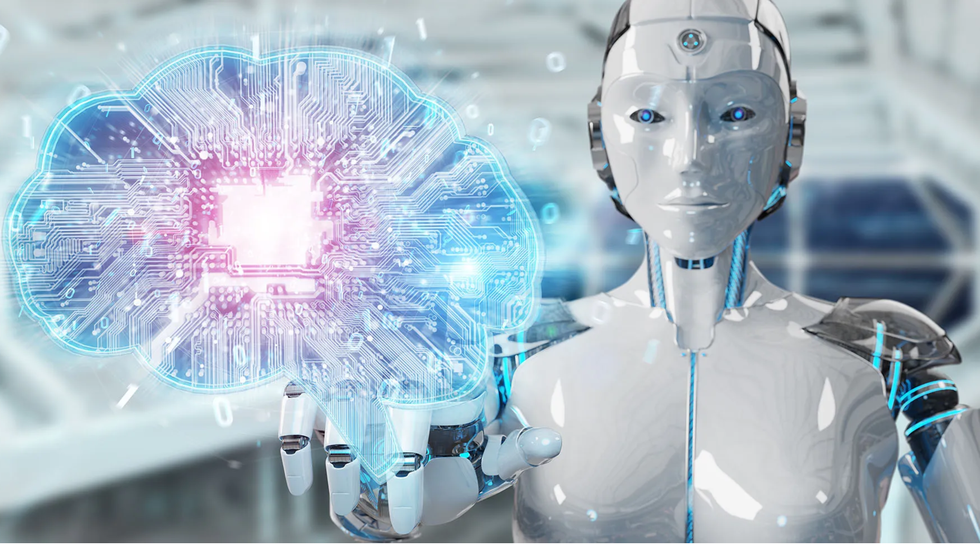
ResNetV2 ARCHITECTURE
42,658,176 Parameters
164 Layers : 7 modules
Poor performance on Dataset : ~25%

Slide 18
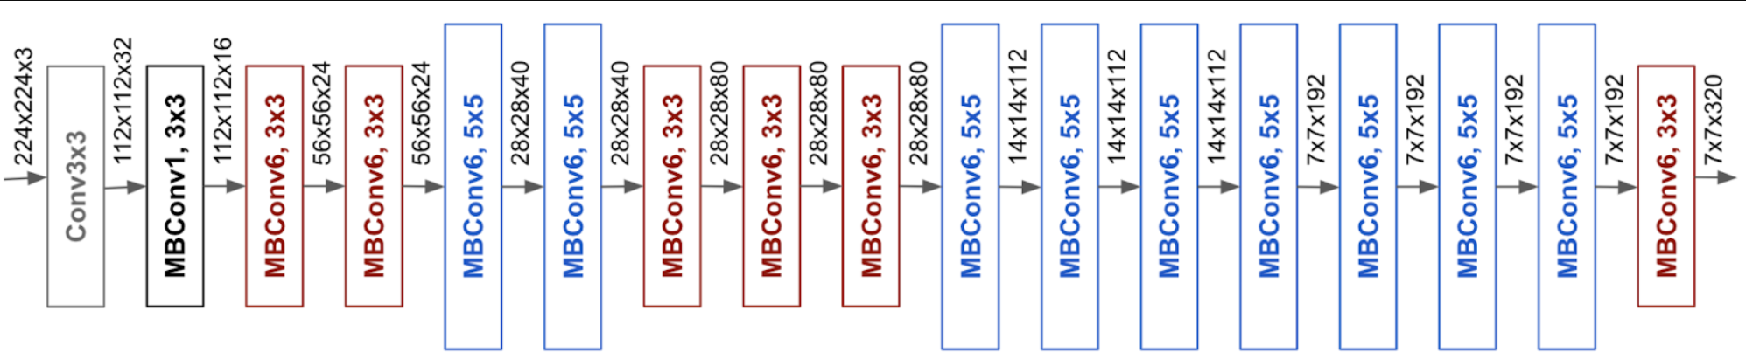
EFFICENTNET ARCHITECTURE
8,769,374 Parameters
813 Layers : 5 Modules
Poor performance on Dataset : ~25%

Slide 19
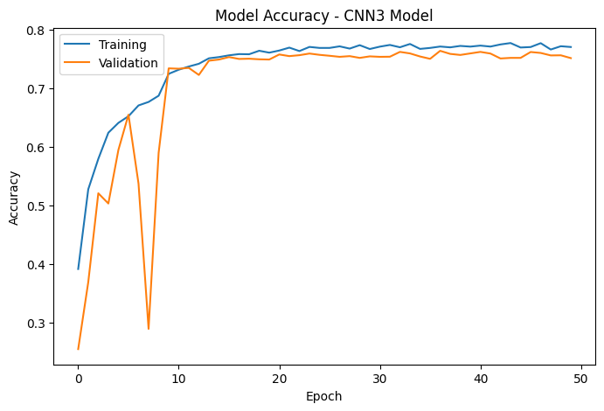
MILESTONE 1 MODEL
Enhanced Version 3 CNN Model
Conv2D Layer Added
More Neurons per Conv2D Layer
Data Loader Augmentation Hyperparameter adjustments
Validation accuracy dips to in Epoch 8?
Notes:
Hyperparameters : Brightness_range, Shear_range replaced with Rotation_range

Slide 20
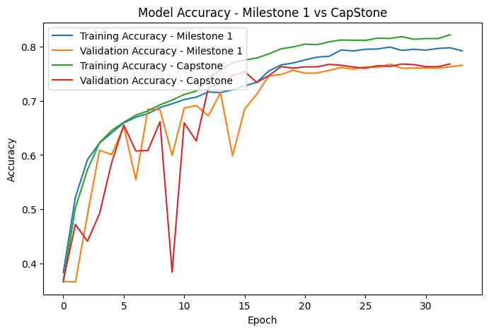
CAPSTONE MODEL
Final CapStone Model Version
Conv2D Layer Added
More Neurons per Conv2D Layer
More parameters : 2,973,700
Notes:
Brightness_range adjusted again
Adjusted Dropout
Best training accuracy, bigger training vs validation gap

Slide 21
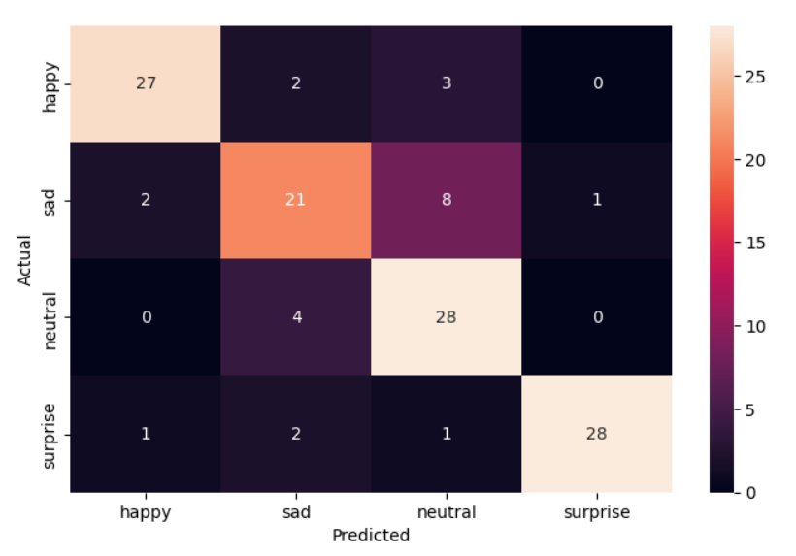
FINAL MODEL HEATMAP
PREDICTED RESULTS vs ACTUAL (Folder)
Notes:
Sad vs Neutral biggest issue
Neutral vertical math?

Slide 22
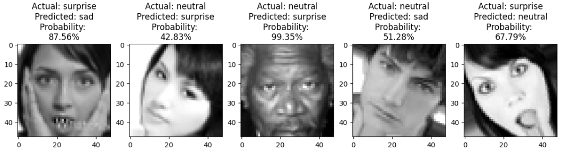
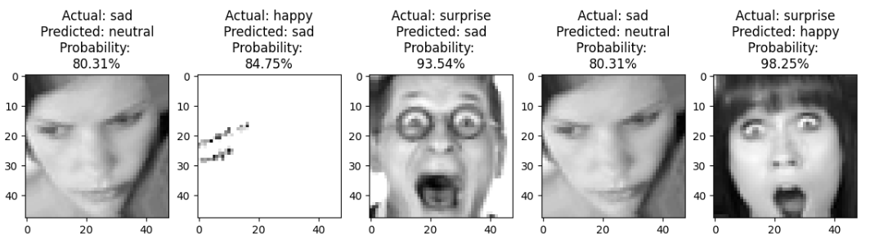
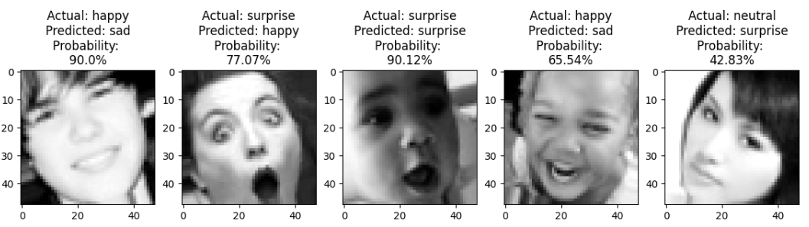
FINAL MODEL MISMATCH IMAGES
Notes:
Morgan Freeman surprised, Justin Beiber sad, strange model predictions

Slide 23
FINAL CNN MODEL ANALYSIS
 | Parameters | Train Accuracy | Train Loss | Val Accuracy | Val Loss | Test Accuracy | Test Loss
Model 1: Grayscale 1 | 605,060 | 0.706 | 0.725 | 0.68 | 0.79 | 0.62 | 0.81
Model 2: Grayscale 2 | 389,604 | 0.796 | 0.496 | 0.715 | 0.74 | 0.68 | 0.68
Model 3: VGG16 | 14,714,688 | 0.72 | 0.687 | 0.675 | 0.815 | 0.72 | 0.71
Model 4: ResNet V2 | 42,658,176 | 0.27 | 1.38 | 0.36 | 1.37 | 0.25 | 1.40
Model 5: EfficientNet | 8,769,374 | 0.27 | 1.38 | 0.37 | 1.35 | 0.25 | 1.41
Model 6: Milestone 1 | 1,592,324 | 0.80 | 0.51 | 0.77 | 0.60 | 0.805 | 0.543
Model 7: CapStone | 2,973,700 | 0.83 | 0.44 | 0.77 | 0.65 | 0.77 | 0.60
Notes:
Train Accuracy consistent up, loss down.
Val Accuracy up, loss down
Test Accuracy, best in Milestone 1

Slide 24
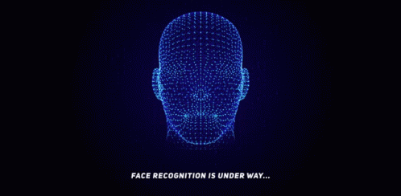
CONCLUSIONS
Less complex models work better with Facial_emotion_images
Transfer learning models mediocre to poor on dataset
Notes:
Selected dataset, simpler is better
Evolution of detection, key edges and features of a particular individual in real time. Eyes, mouth, forehead, chin

Slide 25
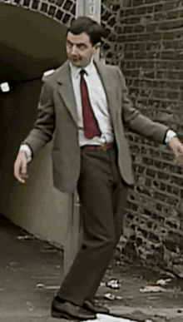
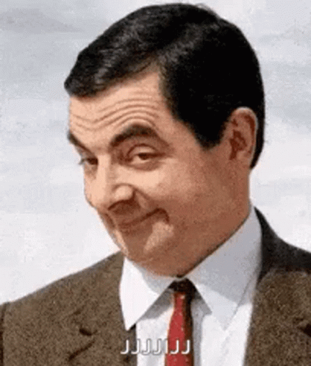
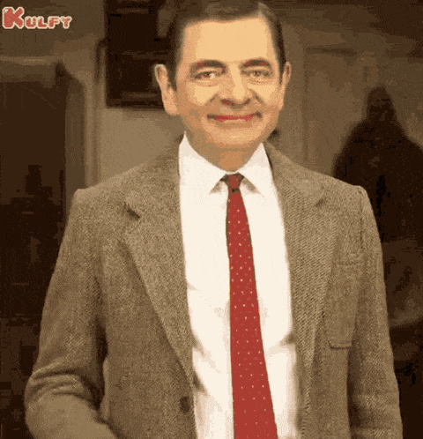
CONCLUSIONS
How did the models come out Mr Bean?

